Slide 1

DriverPass System Analysis
Rachel Iris Aldava
Notes:
[NOTE TO DR. EPPENGER:
The rubric called for clearly articulated explanations and polished grammar. I have written these notes as I would speak in a natural voice during a business presentation. I’ve presented in such an environment many times and have established a successful style which, while professional, is not overly formal. In spoken word there are slightly different stylistic conventions; contraction, for example, are more acceptable and often less awkward. There are also some considerations in terms of how one slide or topic flows into another in order to construct a broader narrative. While I believe I have hit all rubric points, these rubric points might not be neatly isolated from each other in the speaker notes. My working concept for the presentation was that the target presentation time is 15 minutes, with QA afterward.
]

Slide 2

System Requirements
The website must:
Be hosted on the cloud
Support up to 200 people logged in at the same time and be capable of storing information about customer accounts, appointments, test questions, etc.
Enable customers to schedule appointments
Facilitate practice tests for customers
Notes:
[NOTE: The first two are identified as non-functional, the last two are identified as functional. As the distinction between these two types of requirement seems a bit technical, I will not make the distinction during the presentation.]
You indicated that you want this website to be as low maintenance as possible; you want to focus on your business rather than server upkeep. To this end, we have determined that cloud hosting is a requirement for your website. An important thing to consider when buying cloud hosting services is determining how heavy duty the website needs to be. You wouldn’t necessarily need to drive a tractor trailer to pick up groceries, and you wouldn’t want to tow a trailer with a vespa. For your case, we estimate that you won’t need to support more than 200 people using the website at any given point in time, and you will need to be able to have a little bit of storage space.
In the interview it seems like the two most important things your website needs to do is enable customers to schedule appointments and allow customers to take practice tests. We’ll talk more about how we’re going to implement these features in the next slide.

Slide 3
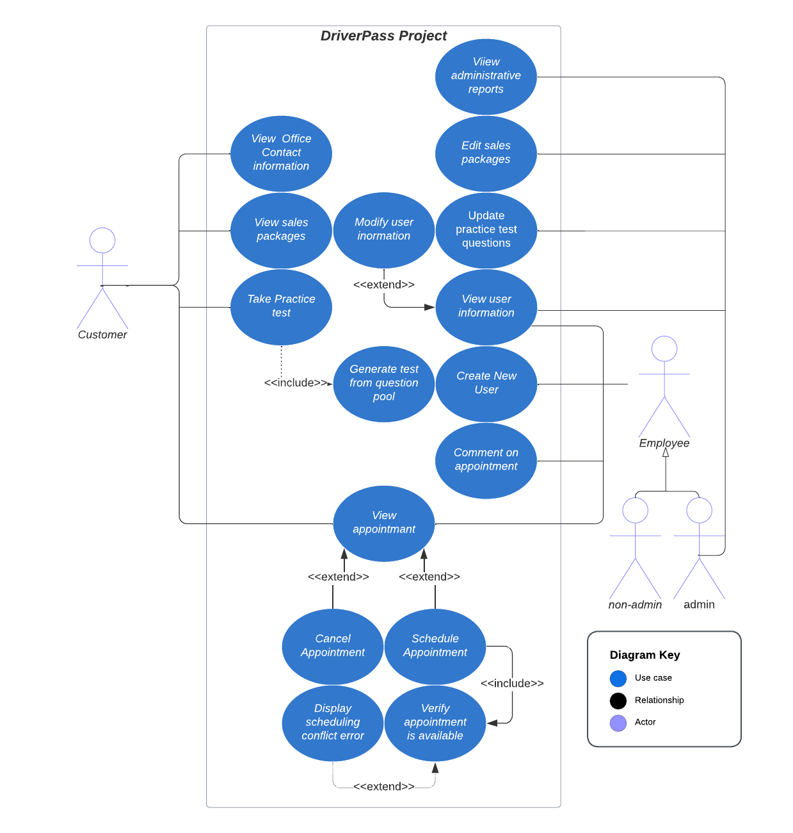
Use Case Diagram
Notes:
Our website will have several different kinds of people who use it. The most obvious folks are, ultimately, the customers, but the employees will use the website too. There are several different roles that an employee can fill, but the most important distinction is whether they have administrative access.
You identified to us your needs for this website; you wanted a website in which customers can view various sales packages, schedule appointments, and take online practice tests. To meet these needs, we have identified the following parts for our website to have: customer will view office contact information, view sales packages, take practice tests, and make appointments. In the diagram, we have left out some implicit design needs such as the capability to log in. Employees, generally, will need to be able to view a customer’s information, create new users, make comments on driving lessons, and manage appointments on behalf of customers. Either customers or employees will be capable of viewing appointments, canceling appointments, and scheduling appointments.
Every time an appointment is being made, we need to check to make sure the driver is available and a car is available; we wouldn’t want to allow customers to overbook by accident. Whenever there is a conflict, we should be capable of displaying an error message to the customer.
Practice tests are another core component of the website, and whenever a customer starts a new practice test the computer will need to generate a test from a pool of possible questions. A requirement of this website was the capability for this question pool to be updated whenever the DMV changes things, so administrators will have access to updating practice test questions.
Administrators will also need some other capabilities such as creating and modifying not only customer accounts, but also employee accounts. They will also need to be able to make changes to the sales packages that are on offer and they should be able to diagnose issues with a variety of administrative reports; as we will see later on, the system will be capable of recording modifications whenever someone makes a change.

Slide 4
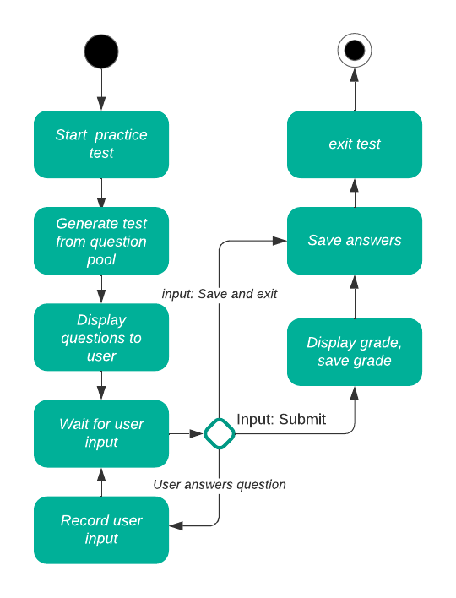
Activity Diagram
Notes:
Let’s look a bit more into how the website will function whenever a customer takes a practice test. It can seem a bit linear at first: The customer starts a test, the computer will randomly populate the test with test questions from the pool, then display those questions to the user. After that, the customer may (or may not) be clicking on various answers to questions and the computer will capture that input. If a customer clicks the submit button, the computer will show a grade for the test and save the grade. Next, the computer will save the answers (and questions!) so that the customer will be able to return to the test any time and see how they answered. Finally, the customer will exit the test. Now, suppose that instead of submitting a test, the customer instead clicks the “save and exit button”; what should happen? All that needs to happen is that we should skip calculating and saving a grade and instead just save the answers and exit the test.

Slide 5
Security
The website will use industry standard secure communications methods
All users will be assigned appropriate permissions
User information, including passwords and credit card numbers, will be encrypted
The cloud webhosting service SKYnet will ensure protection against cyber attacks
All user modifications will be made by employee accounts
Accounts with numerous failed password attempts will be locked until an employee manually unlocks them
Notes:
In our interviews, you indicated that you would prefer this website to have minimal upkeep and for it to be cloud hosted. We selected a company which specializes in cyber attacks and is capable of protecting the website against the latest attempts by malicious attackers. Within the website, users will only have the permissions which they need. Web traffic to and from the website will use encrypted methods which are also used by banks worldwide. Sensitive information about user accounts will be protected with the latest in data security technology. Our top security consultant, Merlin, has specially designed a revolutionary method of protecting the database against attacks.
In the event that a customer forgets their password, or in the event that someone fraudulently attempts to reset the password of an account which doesn’t belong to them, they will need to place a phone call with the office and verify their credentials with the office employee, who would then be able to reset the password once a user’s identity is appropriately established. In the event that a user inputs a password incorrectly multiple times, their account will be locked and the user will be prompted to call the office in order to get the account unlocked again.

Slide 6
System Limitations
Budget- as a startup, revenue may be limited.
Time- as a startup, time is a priority so that the business can start building revenue.
Must be hosted on the cloud.
Customers and employees will need internet access in order to use the system
Notes:
One thing we need to consider about this system is what sort of resources we have at our disposal in terms of funding. As a startup company, you don’t have an established customer base, so your revenue will take some time to build. When developing this website, we will need to keep in mind that we need to be able to produce a functioning website using the funds that you already have.
Another thing to consider is the timeframe we need to work with. This goes hand in hand with budget concerns in that you will need this website up and running before you can start to gather customers. We need to develop this website with a sense of urgency and avoid spending time on non-essential features for now.
As mentioned previously, this website will be on the cloud. Developing for the cloud is different from developing for physical computers, but we are familiar with the technical side of things. One important consideration is that this is a monthly expense for as long as the website is operational. We don’t anticipate it will be too expensive, but it will be something to keep in mind.
And because this system is cloud hosted, this introduces another limitation: internet access. In order for a customer or employee to use the website they will need to be connected to the internet. This could mean that your drivers will need to head inside and sit at a desk in order to finalize appointments, or it could mean that your drivers will be issued tablet devices with internet connections. You did mention that you wish to use the system offline and we will design the system to allow you to download reports for offline work, however, for a driver to finalize or comment on an appointment they will need to be online.

